Slide 1
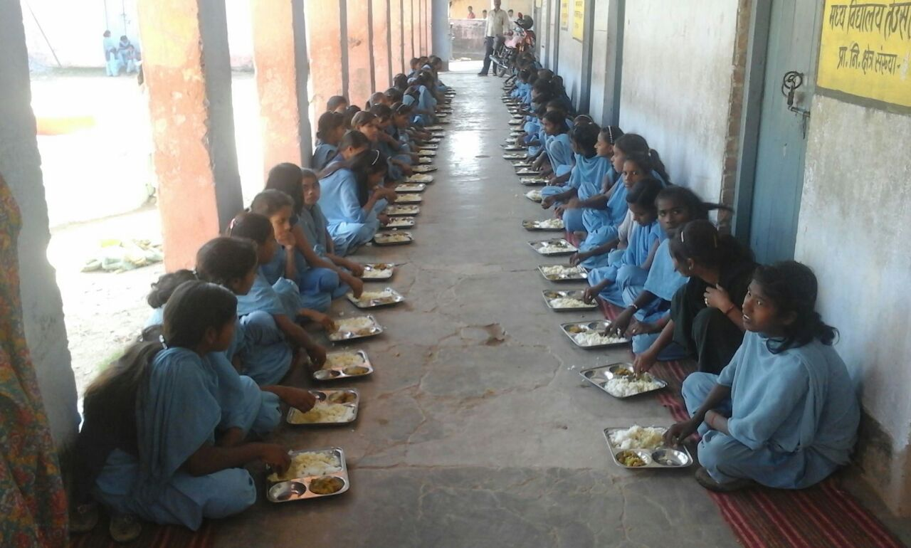
ANNUAL WORK PLAN & BUDGET-2018-19 PAB MEETING 20.06.18 Directorate of MDM EDUCATION DEPARTMENT GOVT. OF BIHAR

Slide 2
GOAL
100% coverage of school attending children
Ensuring quantity, quality, hygiene and timeliness in food served
Timely payments – salary, honorarium to cook cum helper, vendor payments, etc.
Timely and accurate reporting

Slide 3
MANAGEMENT STRUCTURE-MDM BIHAR
State Level
Department of Education/ Departmental Ministers/ Principal Secretary-cum-Chairman BRMBYS
Directorate of MDM/Bihar Rajya Madhyan Bhojan Yojana Samiti (BRMBYS)
State level steering cum Monitoring committee –Headed by Chief Secretary
Director/Dy.D/Asst. Dir
/Monitoring officer /Account officer/Data officer/ APC/Nutrition Expert/ Accountant/Asst/ Steno/Computer Operator
District Level
District ProgrammeO fficer
DC/DRP/Accountant / Executive Assistant
District level steering cum Monitoring committee –Headed by DM
Block Level
BLOCK RESOURCE PERSON (BRP)
Block level Steering cum Monitoring committee Headed by BDO
School Level
Vidyalaya Shiksha Samiti (VSS) -
Headmaster/Senior Teacher
Vidyalaya Shiksha Samiti (VSS)

Slide 4
Tablet Based Monitoring
Tablet based Special inspection drive was conducted during 10.7.2017 to 10.8.2017 to ensure cleanliness of kitchen shed to provide safe and hygienic food to the children.
All education department officer/ staff participated during this special inspection drive for the success of this drive.
All Tablet based Inspections are photographed with longitude and latitude as well as date and time.
Inspection data collected and presented in digital form f0r future use.
This ensures Inspection with reliability and authenticity apart from easy record keeping of huge inspection database. Con’t………...

Slide 5
Tablet based Monitoring
All District and Block officer provided tablet and CUG connection.
Facilitate tablet based inspection in offline mode .
Implementation of mobile based inspection system – geo-tagging and time-stamping of inspection photos
Ensures actual visit/inspection of schools.
Offline data capture: No need of internet connection for date time and location stamping of photograph. (automatic stamping by device).
Inspection data available on MIS database
Improves data integrity
Improves quality of MDM by ensuring actual inspections
Data Entry in offline mode then synchronise data with server when internet available.
Con’t………..

Slide 6
Outcomes of Monitoring
Total no of tablet based inspected done from April-17 to Mar-18 - 95799 .
Total irregularities found in 1476 schools in tablet based inspection .
Total recovered amount is Rs. 4,06,25016 against fine imposed of Rs.8,54,83,836 to head master till march1-18 .
Departmental proceeding started / FIR lodge on 19 head master for irregularities found in school.
One District Programme officer suspended .
Also Departmental proceeding started on 2 other District Programme officer
1 Block Resource person (BRP) terminated

Slide 7
Best Practices
State has provided fund for LPG connection with stove and fire extinguisher to all school.
State is providing Egg/Fruit once in a week.
Availability of bank account details of cook-cum-helpers in the Online MIS.
District MDM office directly transfer of honorarium of Cook cum helper from district to CCH account through RTGS on the basis of absentee entered by the concerned BRP in online MIS per month.
Can't

Slide 8
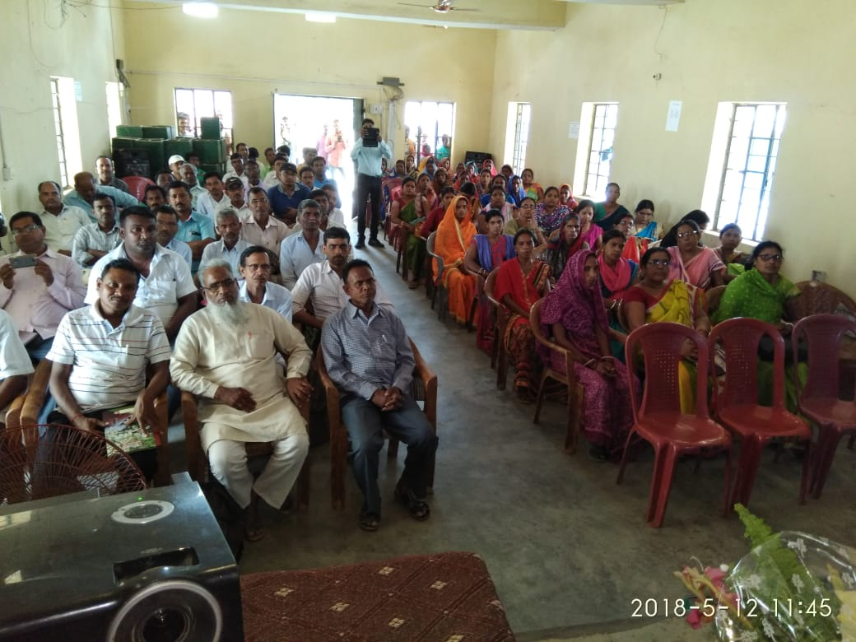
Best Practices One day training programme of 220000 cook cum helpers was organized in all districts on a rotational basis from 25.4.18 to 30.5.18 for preparation of safe, hygienic and nutritious food

Slide 9
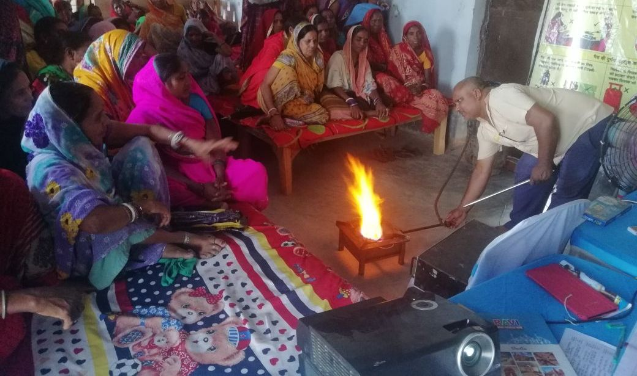
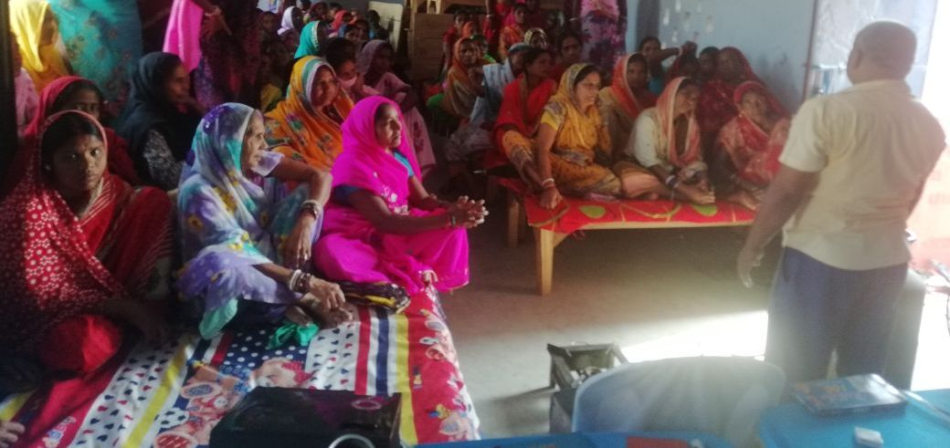
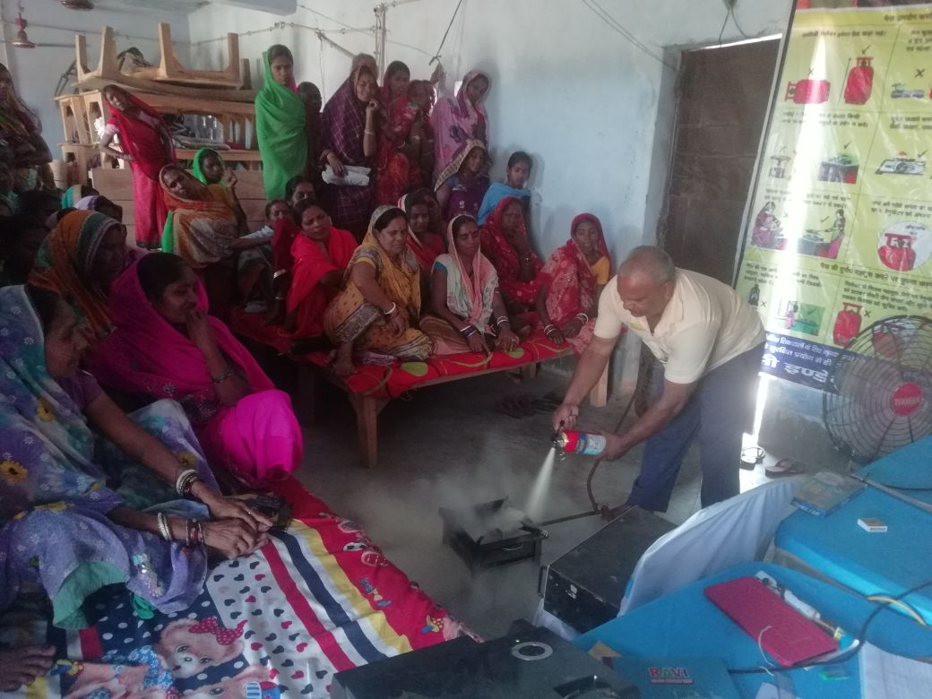

Slide 10
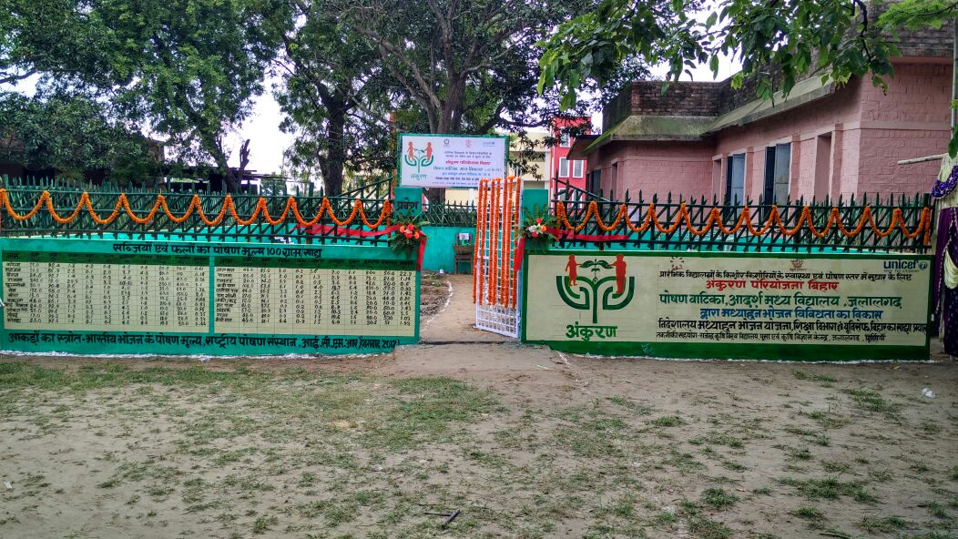
KITCHEN GARDEN - ANKURAN
The main objective of kitchen gardens to provide required vegetables & green leaves in schools with the help of kitchen garden for MDM.
State has started school kitchen garden “Ankuran “ with help of UNICEF in 100 schools as pilot project.
After success of this pilot project state is scaleup “Ankuran” in all district where school having proper land for kitchen garden.

Slide 11
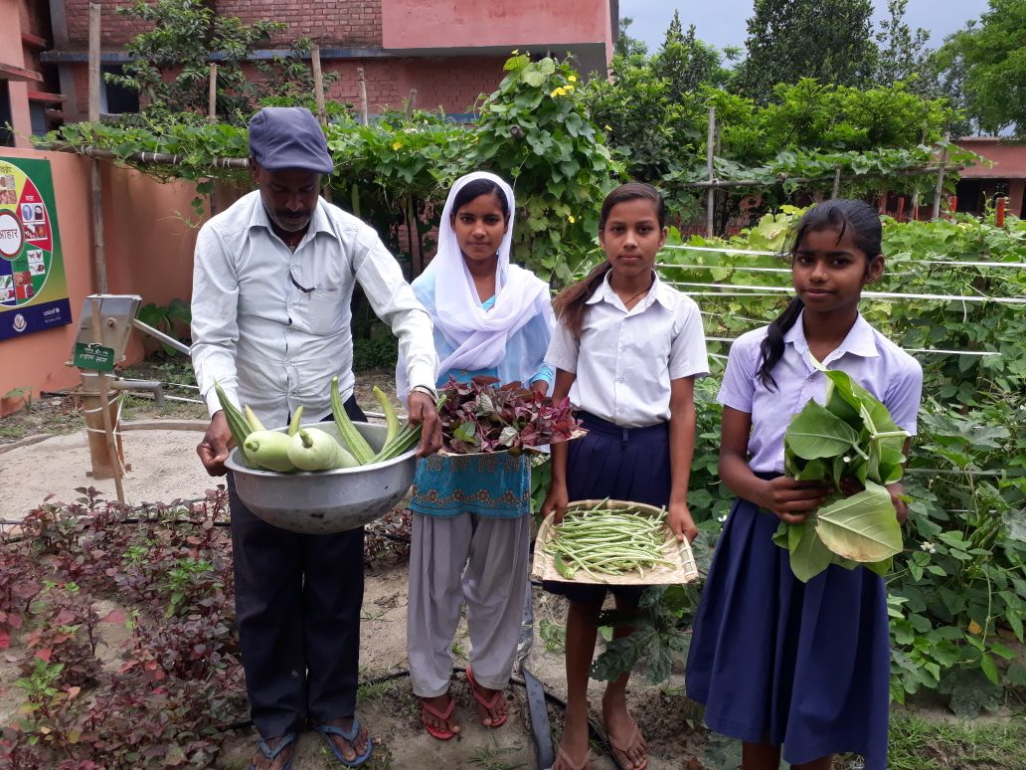

Slide 12
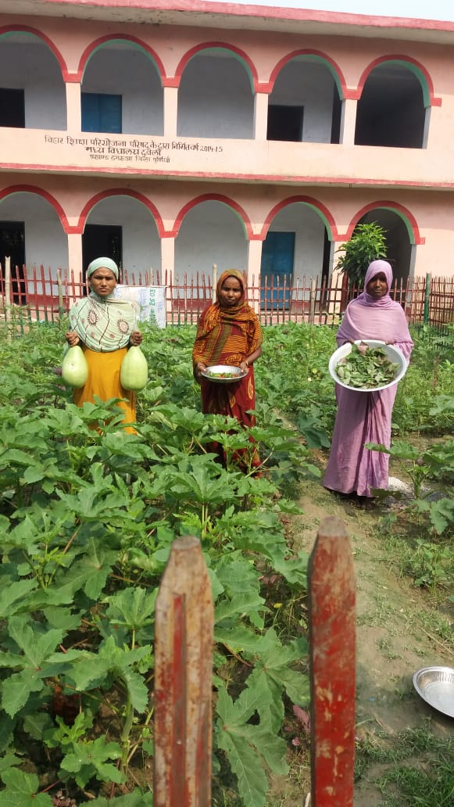

Slide 13
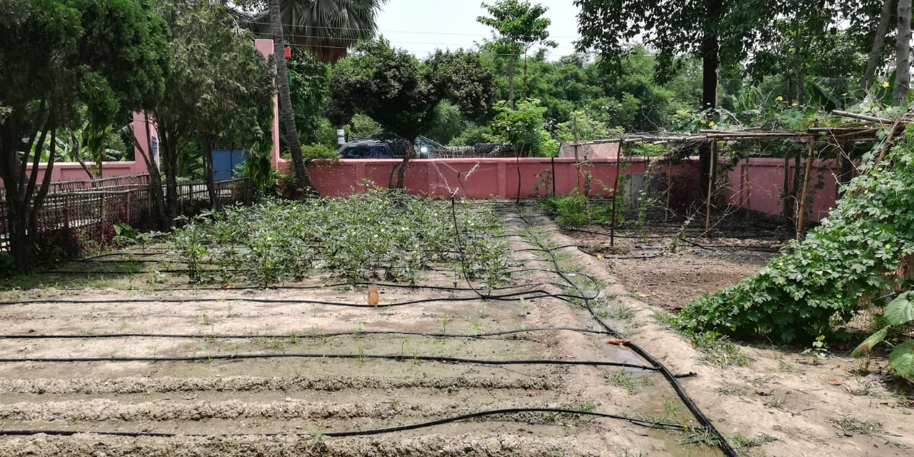

Slide 14
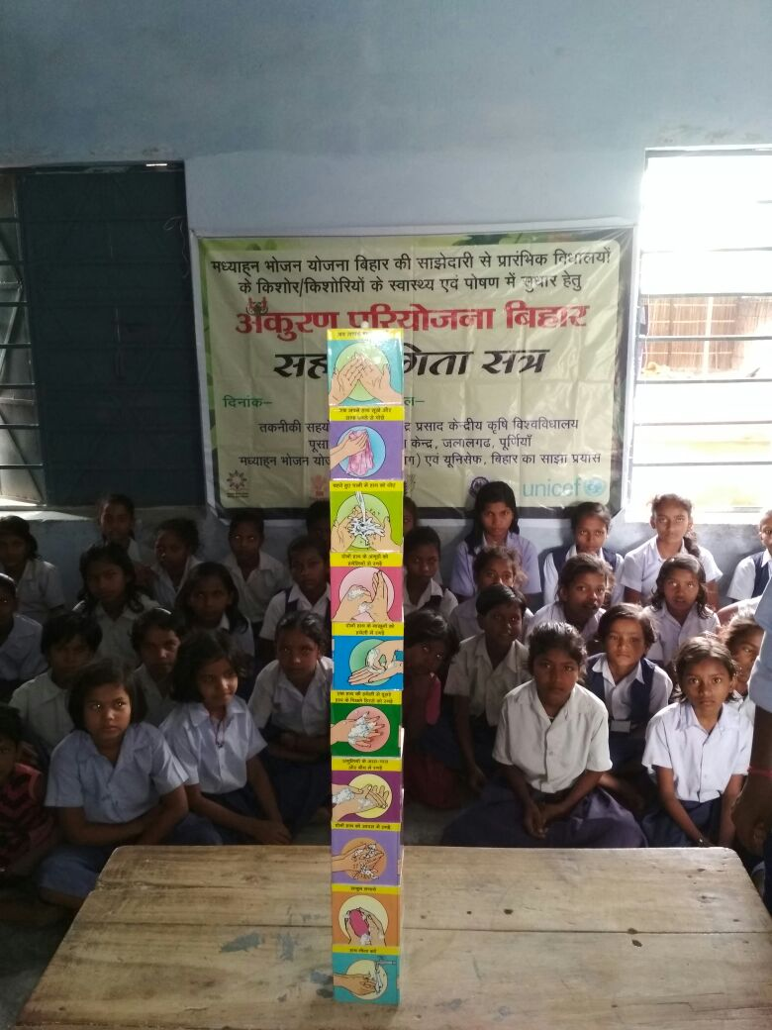

Slide 15
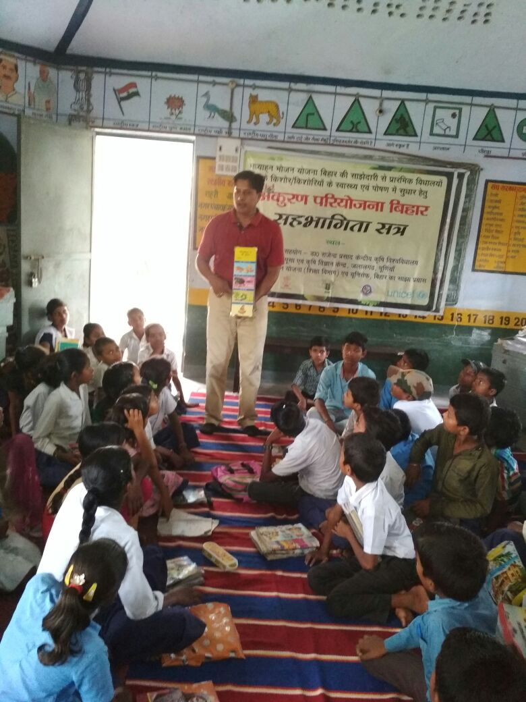

Slide 16
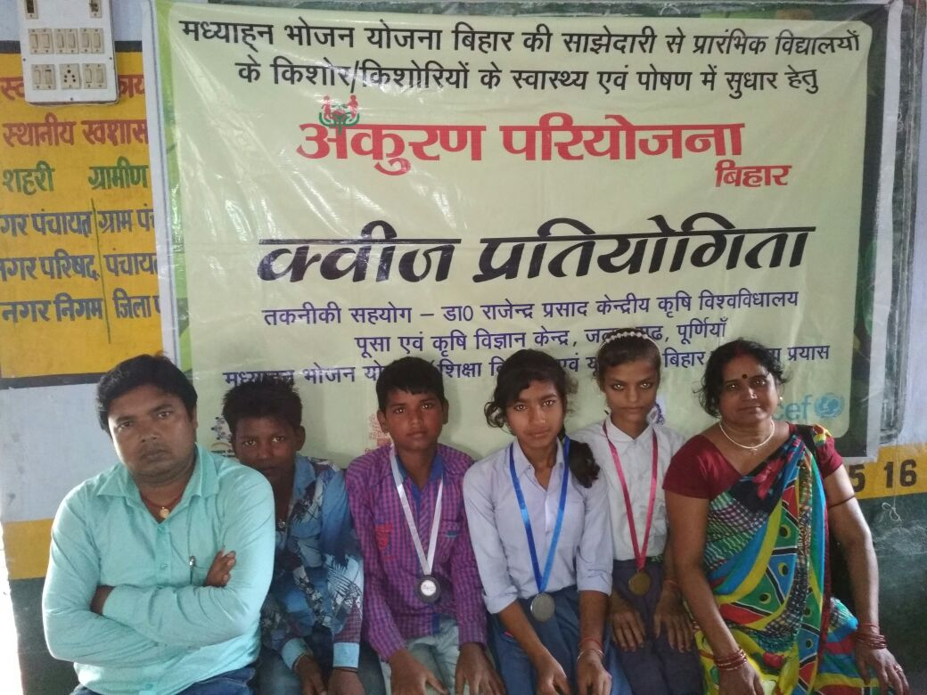

Slide 17
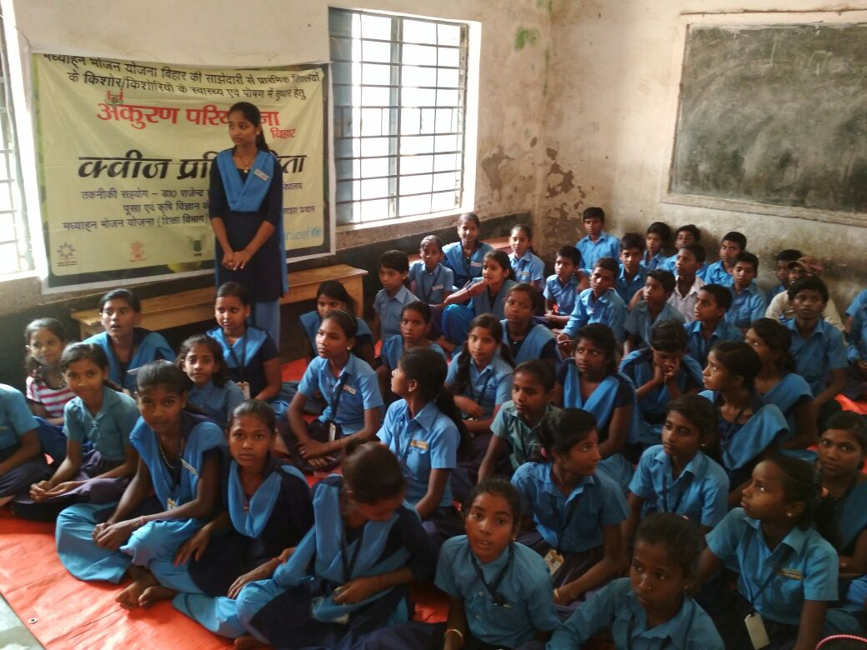

Slide 19
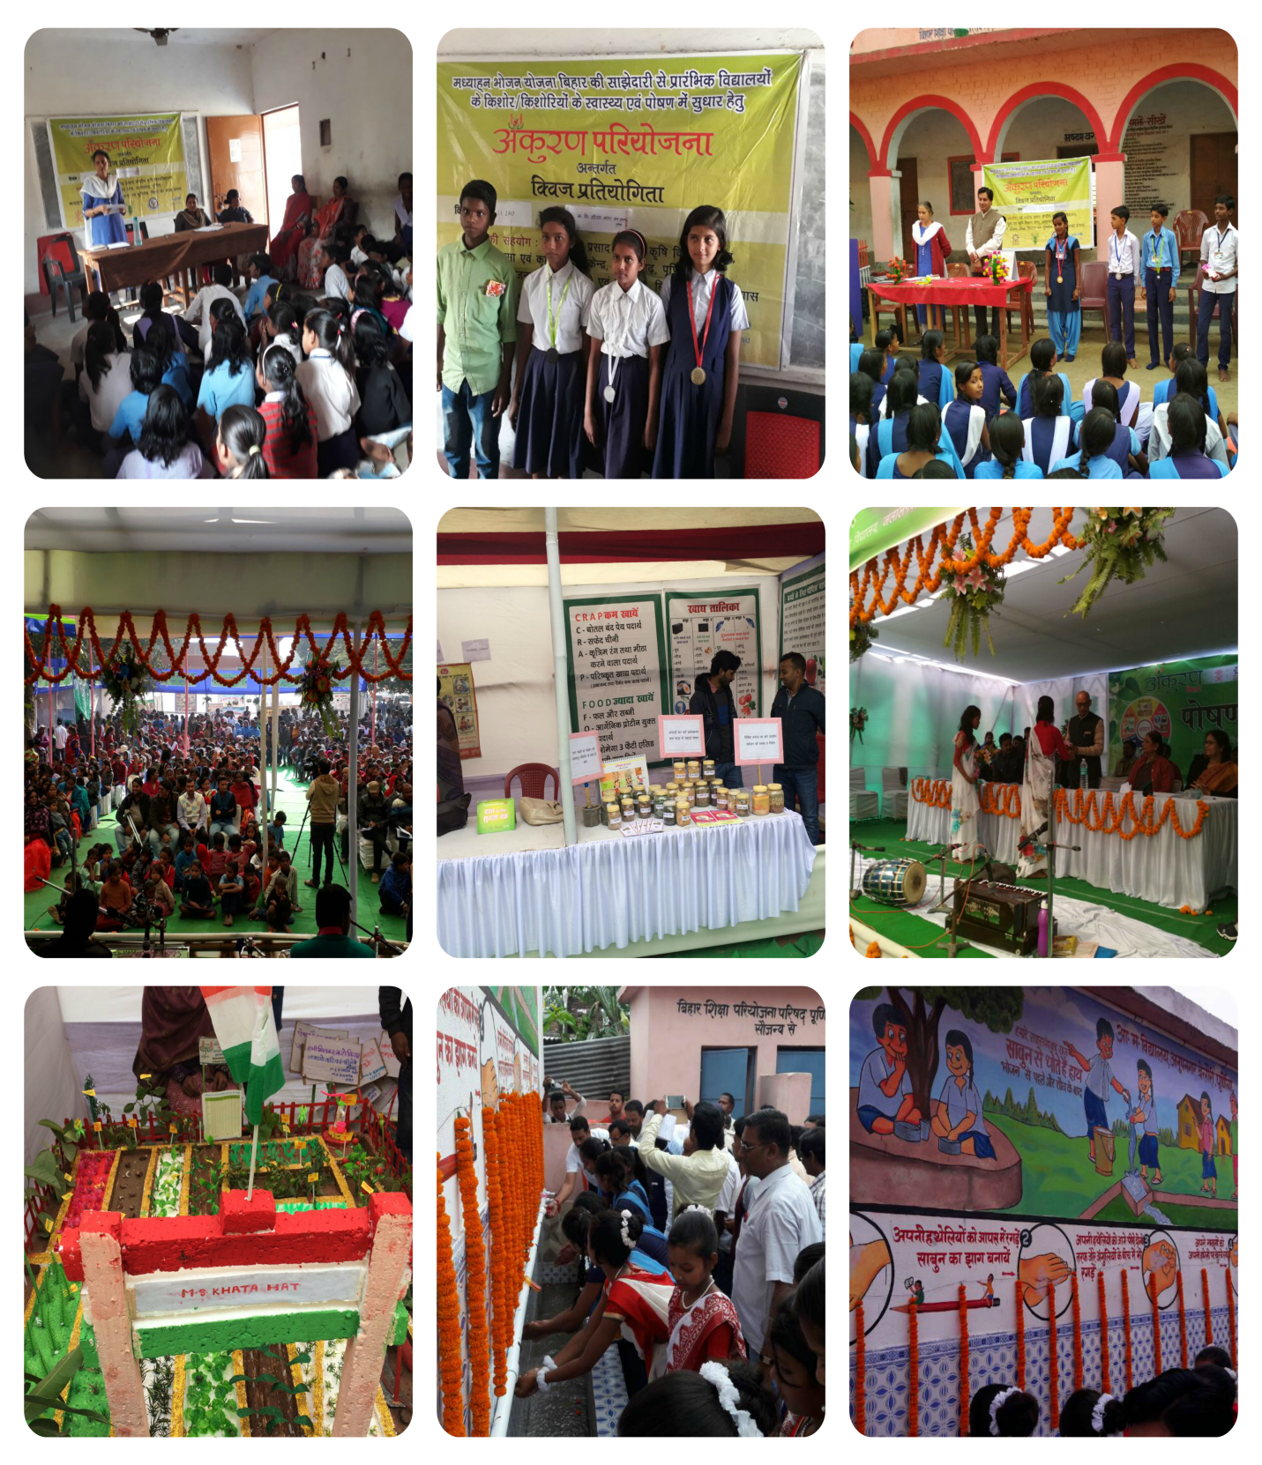

Slide 20
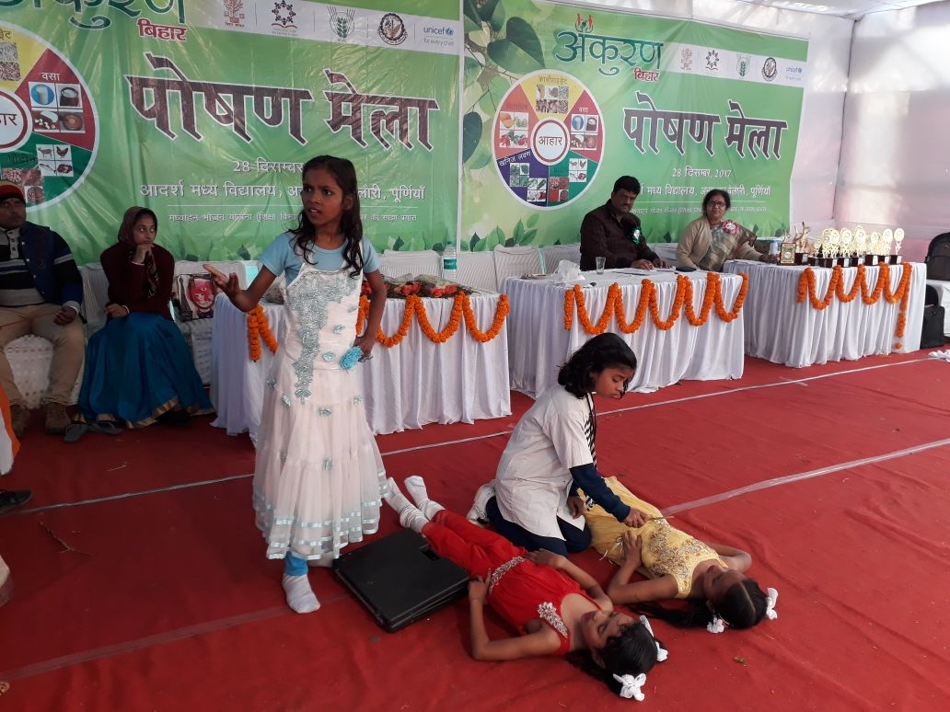
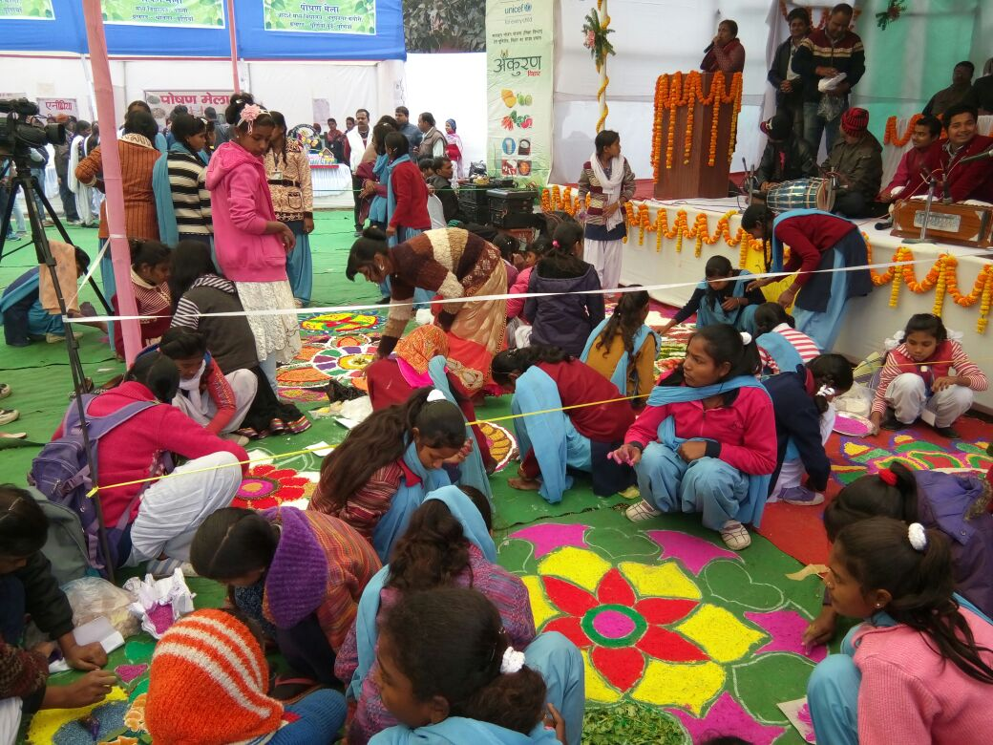
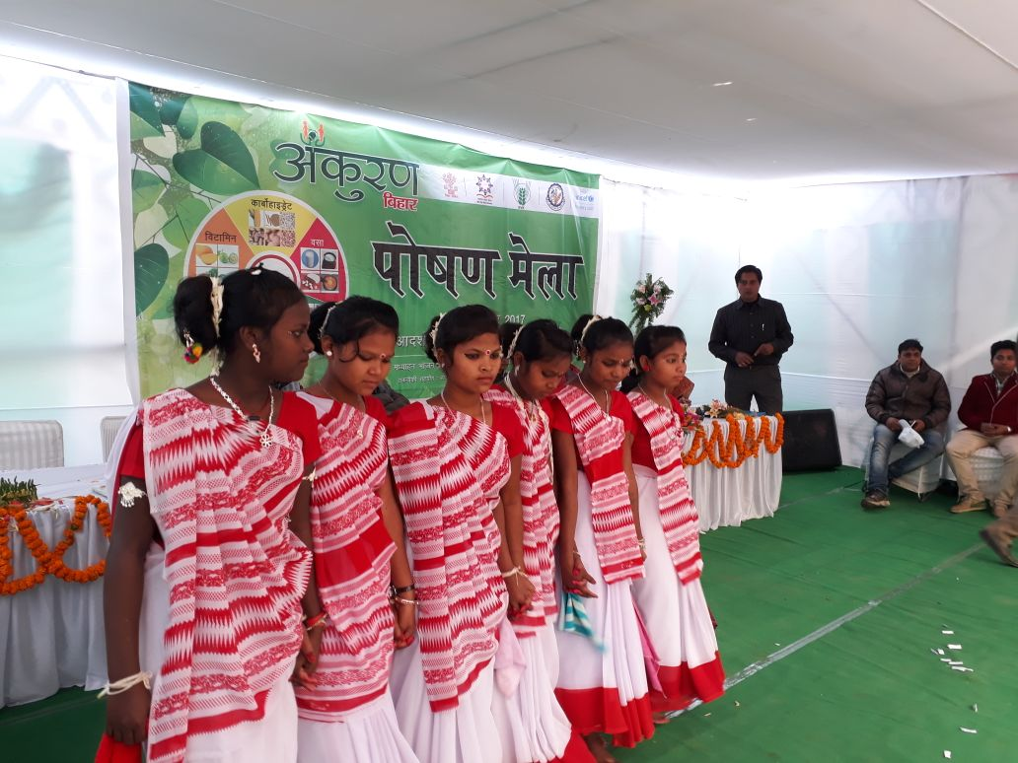
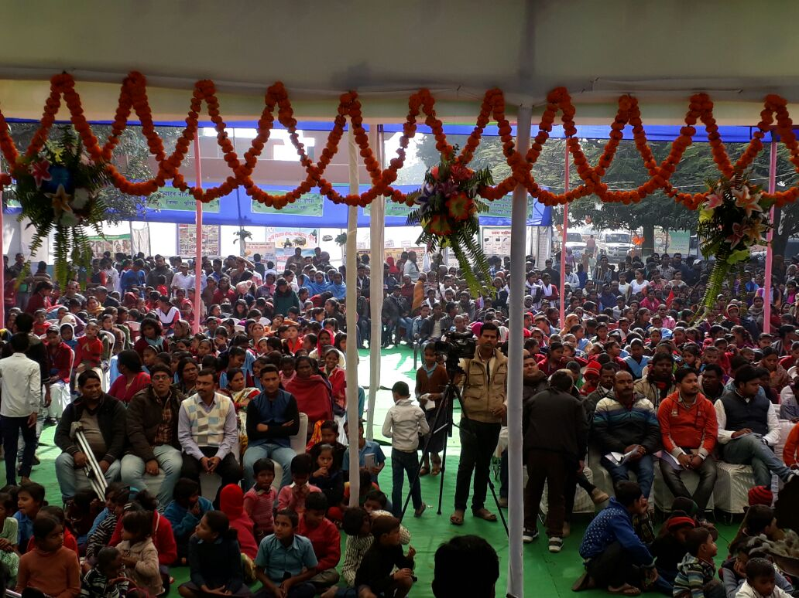

Slide 21
ISSUES / SUGGESTIONS
Increase in monthly honorarium of cook-cum-helper from Rs. 1000/- to Rs. 2000/-
Increase in the rate of transportation cost from 750/- per MT which is not been revised since 2006.
Grant for kitchen device needs to be increased from Rs. 5000 per school to Rs.15000/- per school.
Increase in MME from 1.8% to 4.0%
Additional fund requirement for providing egg twice in a week for the financial year 2018-19.

Slide 22
Proposal for 2017-18

Slide 23
Proposed Provisions for 2018-19
Component | Provision in 2017-18 | Proposed Provision in 2018-19
Per day Beneficiary (Primary) | 9030199 | 9030199
Per day Beneficiary (Upper Primary) | 3781988 | 3781988
NCLP (National child labour project) | 4000 | 0
No of Days | 245 | 245
Cost of Food grains | Rs.3120 per M.T | Rs.3120 Per M.T
Cooking cost (Primary) | Rs.4.13 | Rs.4.44 (7.5% increased)
Cooking cost (Upper primary) | Rs.6.18 | Rs.6.64 (7.5% increased )
Transportation Assistance (Per M.T) | Rs. 750 | Rs.1500
Cook Cum Helper | 2,45,316 | 2,45,316
MME | 1.8% | 4%
Honorarium to Cook-cum-Helper (per cook) | Rs. 1000 | Rs. 2000 (additional Rs. 250 is being given from state resources)
Kitchen-cum-store | 0 | 0
Kitchen Devices per school | 0 | 35760 @Rs.15000/-per school

Slide 24
Proposed Budget Provision for 2018-19 (Financial)
COMPONENT | Budget Provision in 2017-18 (Lakhs) | Proposed Budget Provision in 2018-19 (Lakhs)
Cost of foodgrains | 11244.95 | 11244.95
Cooking Cost | 148712.3 | 148635.15
Transportation Assistance | 2703.11 | 5406.22
MME | 2123.22 | 4716.30
Honorarium to Cook-cum-Helper | 24531.40 | 49063.20
Kitchen-cum-store | 0 | 0
Kitchen Devices (Replacement) @Rs.15000/- per school | 0 | 5364.00
TOTAL | 189314.98 | 224429.92

Slide 25
Thank You
THANK YOU

